Slide 1
Data driven D365BC go-lives
Using telemetry, Power BI app, Alerts, and Power BI metrics

Slide 2
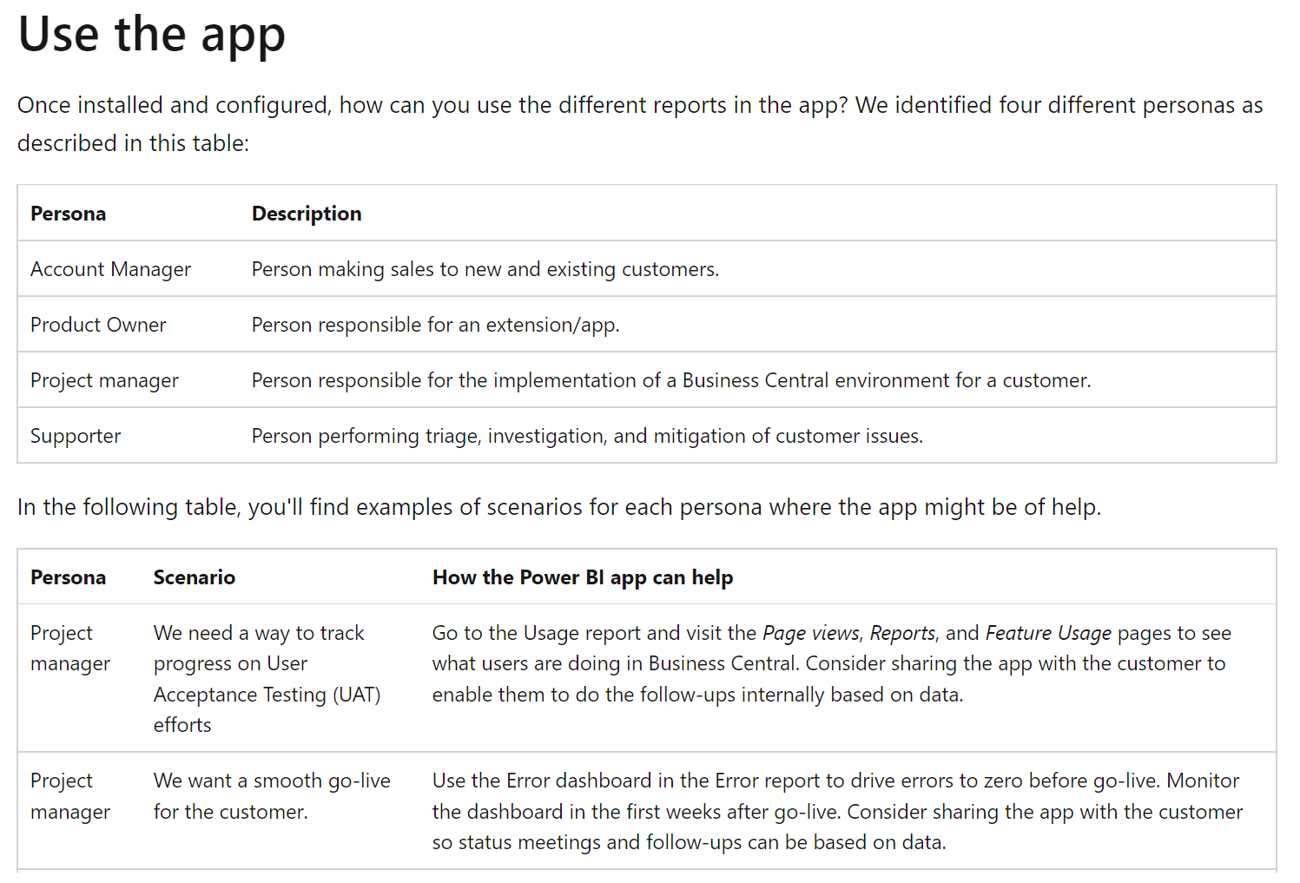
Go-live usage scenarions for Power BI app on telemetry
https://learn.microsoft.com/en-us/dynamics365/business-central/dev-itpro/administration/telemetry-power-bi-app#use-the-app

Slide 3
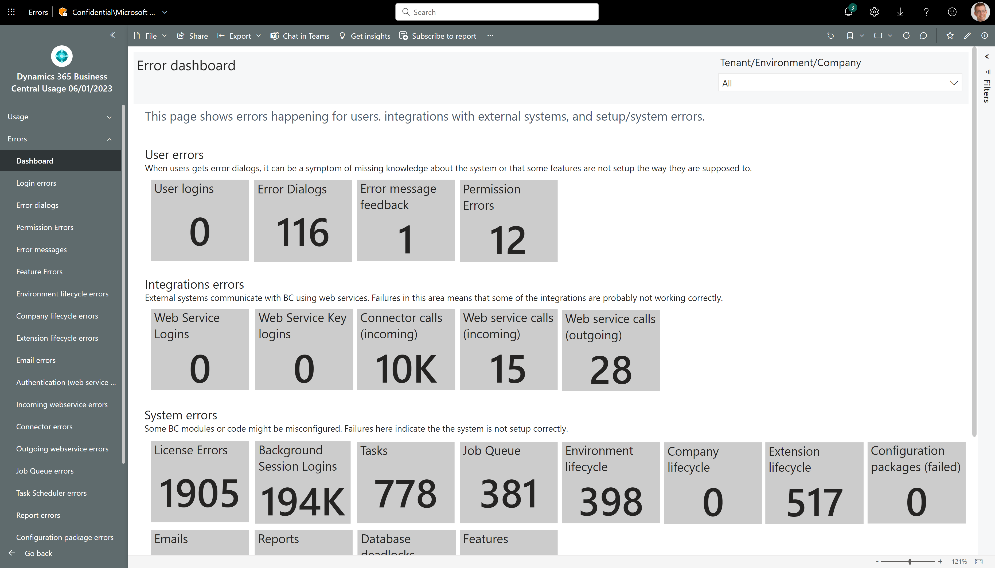
Challenge: hard to track progress from the error dashboard

Slide 4
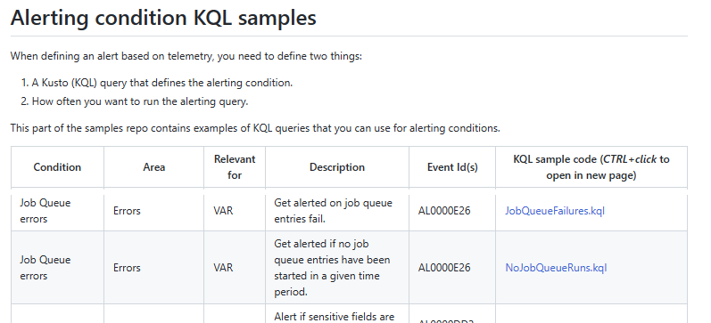
Recommended: Set up alerts during go-live
https://learn.microsoft.com/en-us/dynamics365/business-central/dev-itpro/administration/telemetry-alert

Slide 5
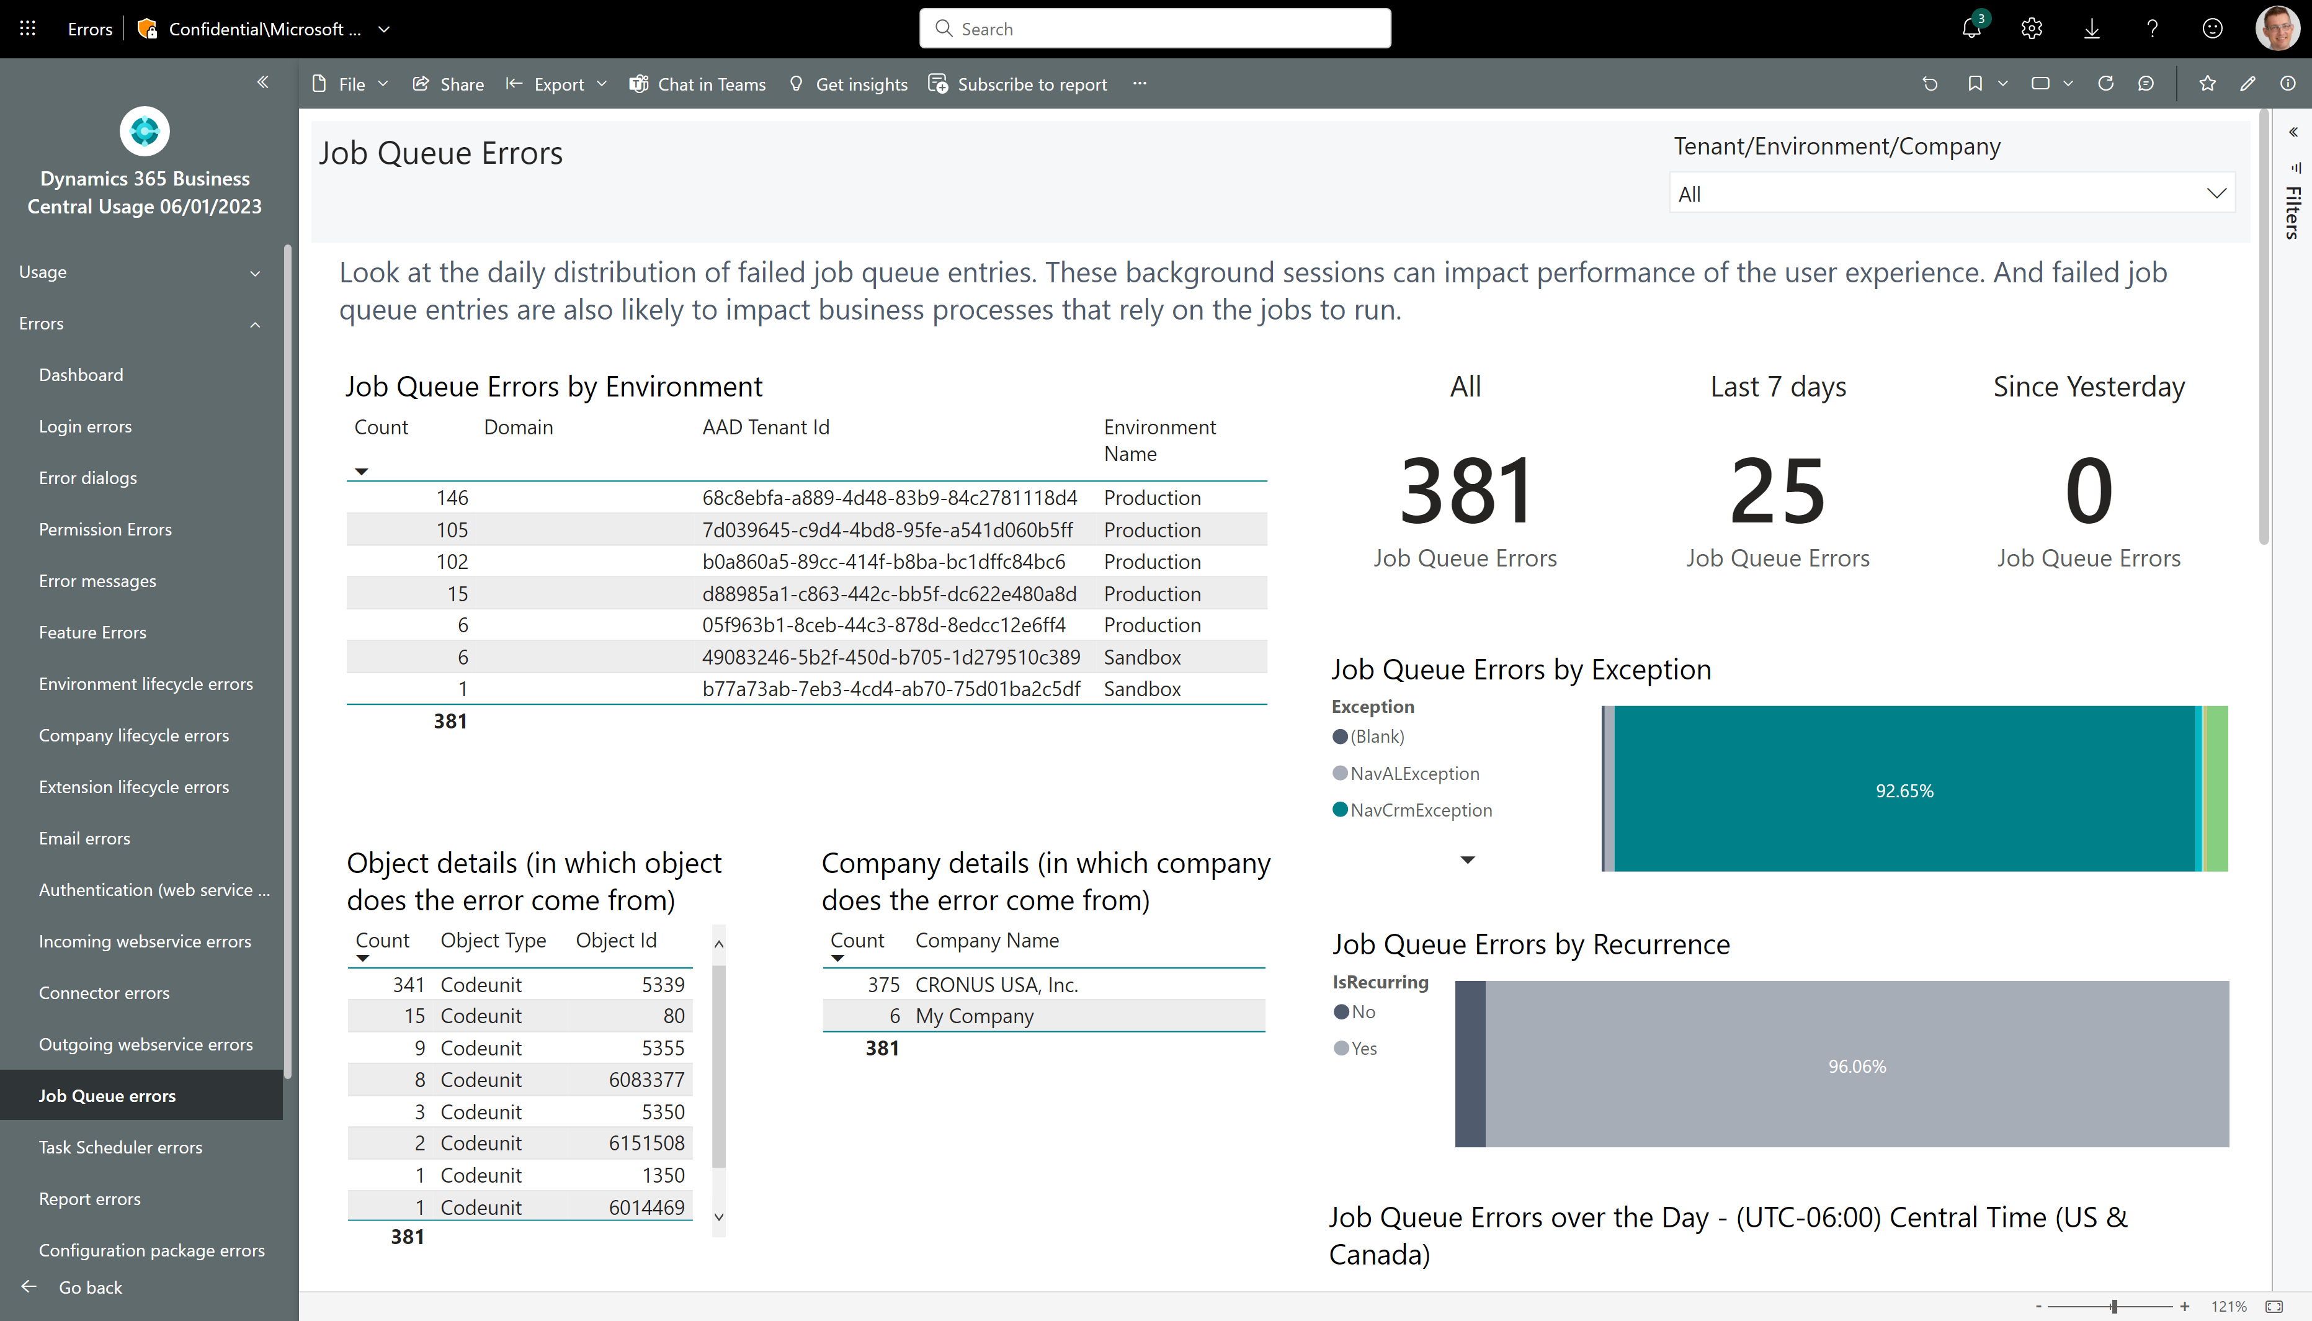
New in February 2023 release: All/Last 7 days/Since Yesterday measures on all error pages

Slide 6
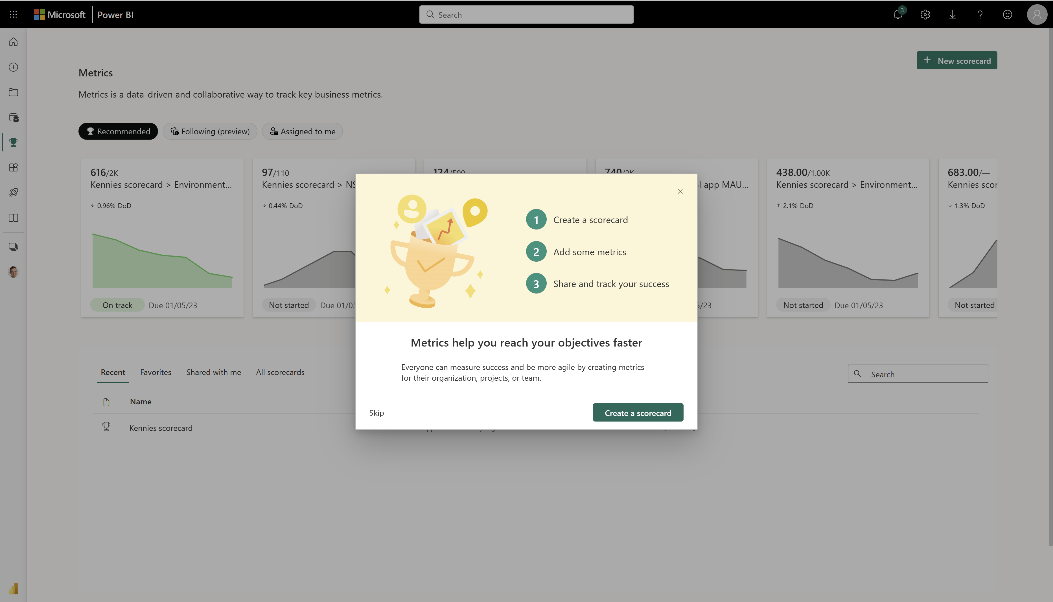
Add Power BI Metrics to the mix…

Slide 7
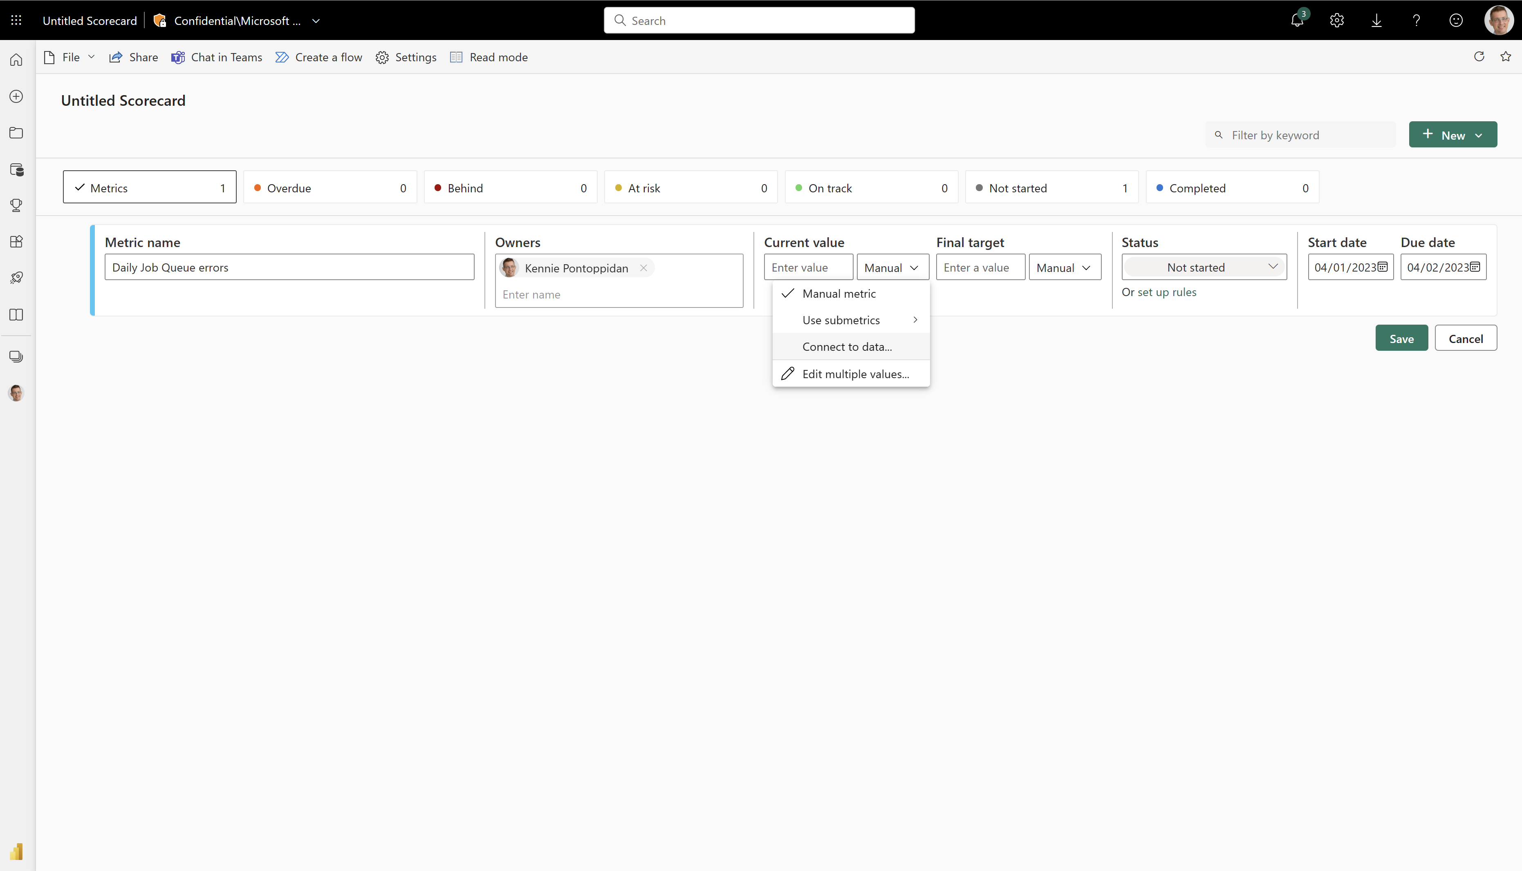

Slide 8
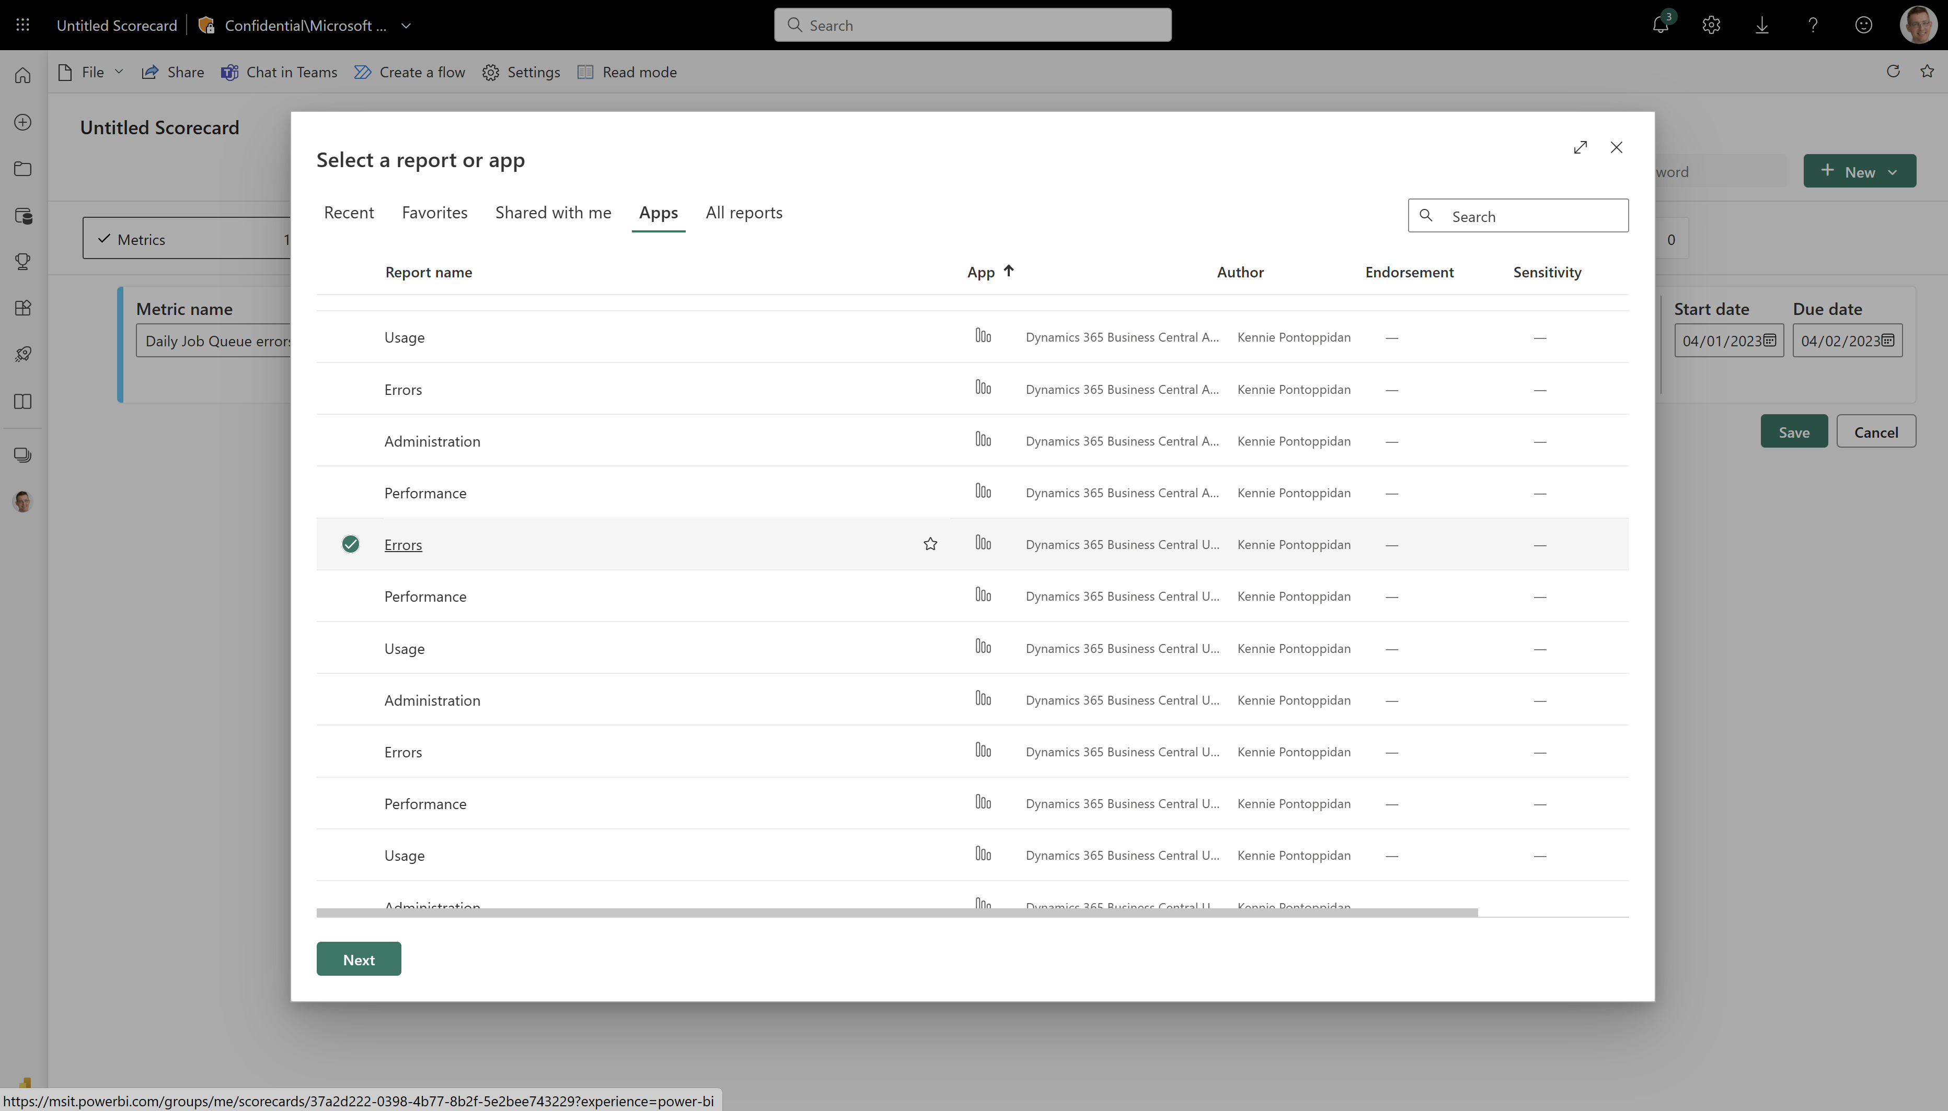

Slide 9
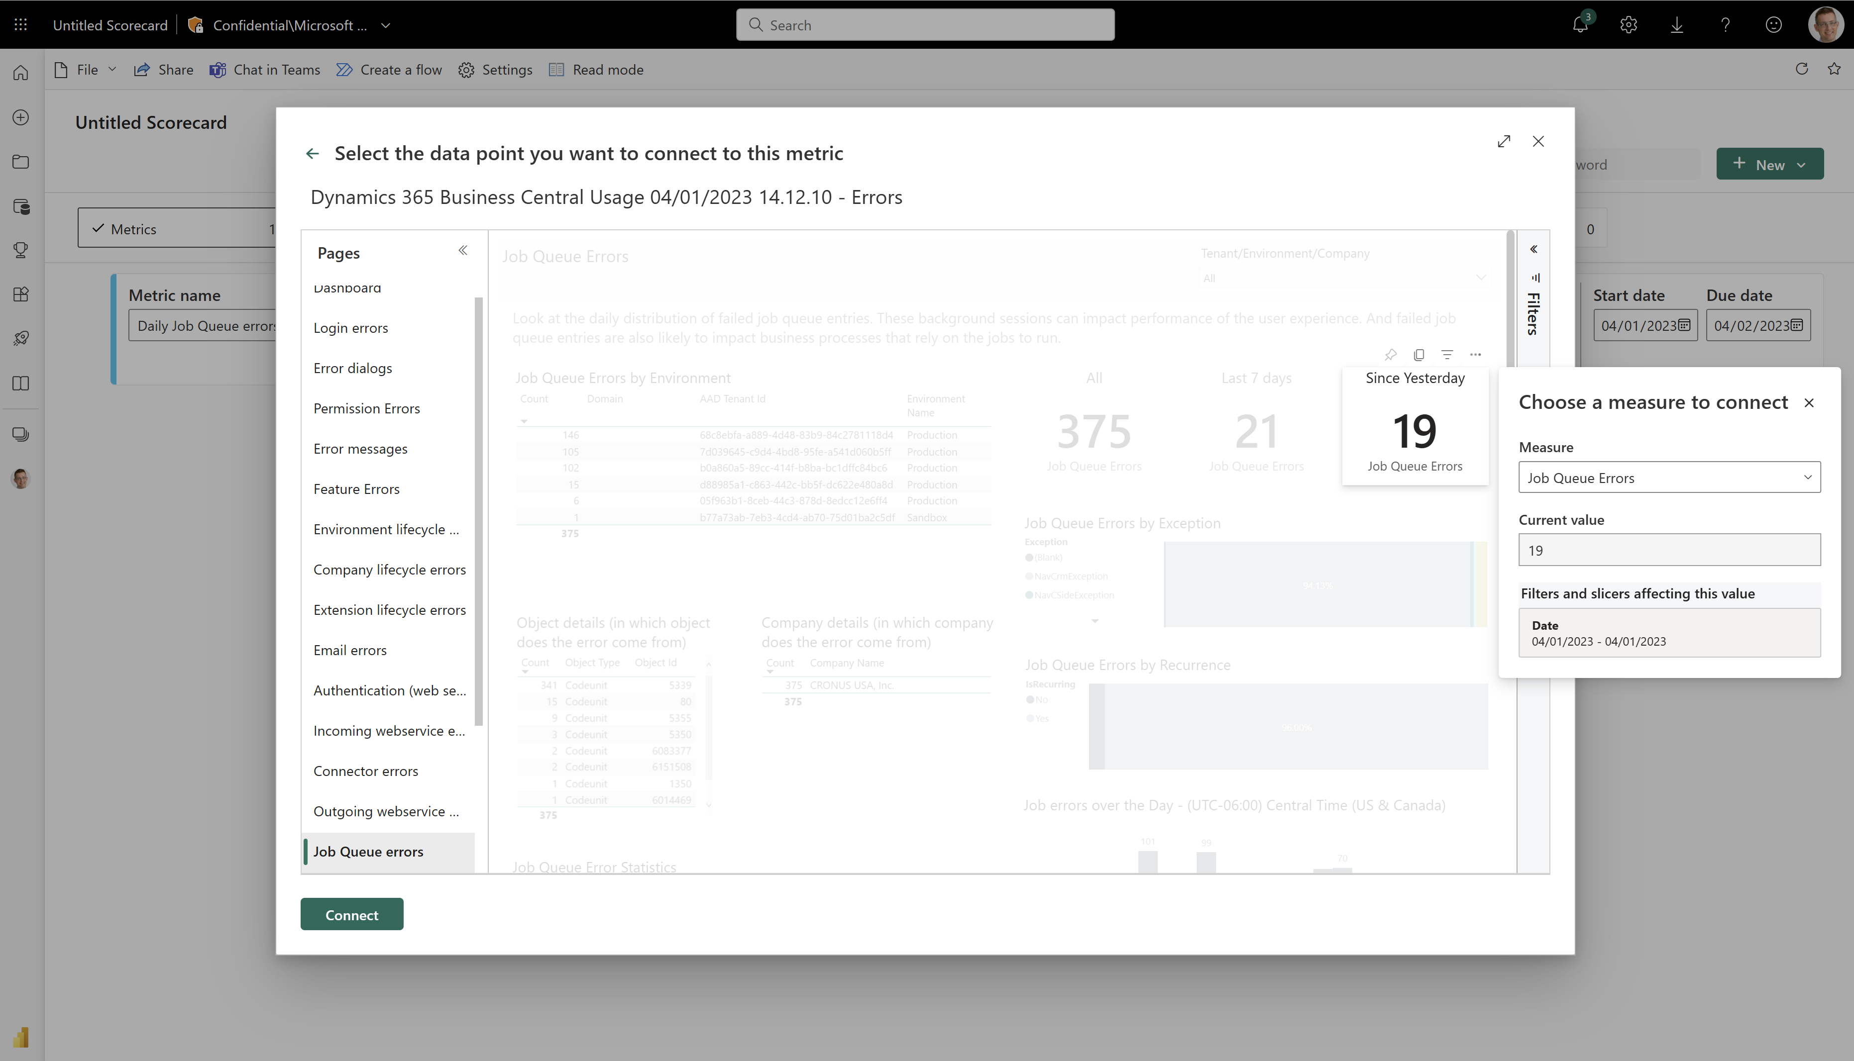

Slide 10
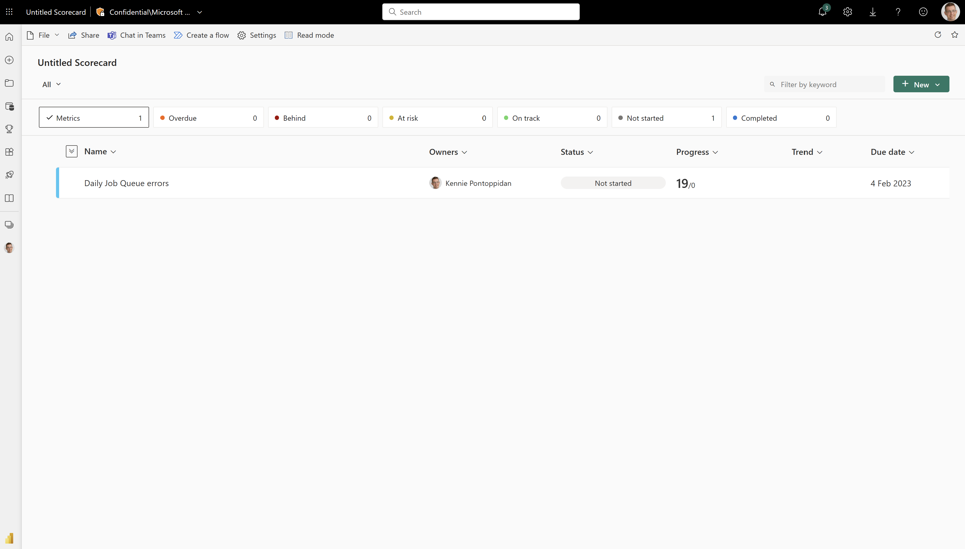

Slide 11
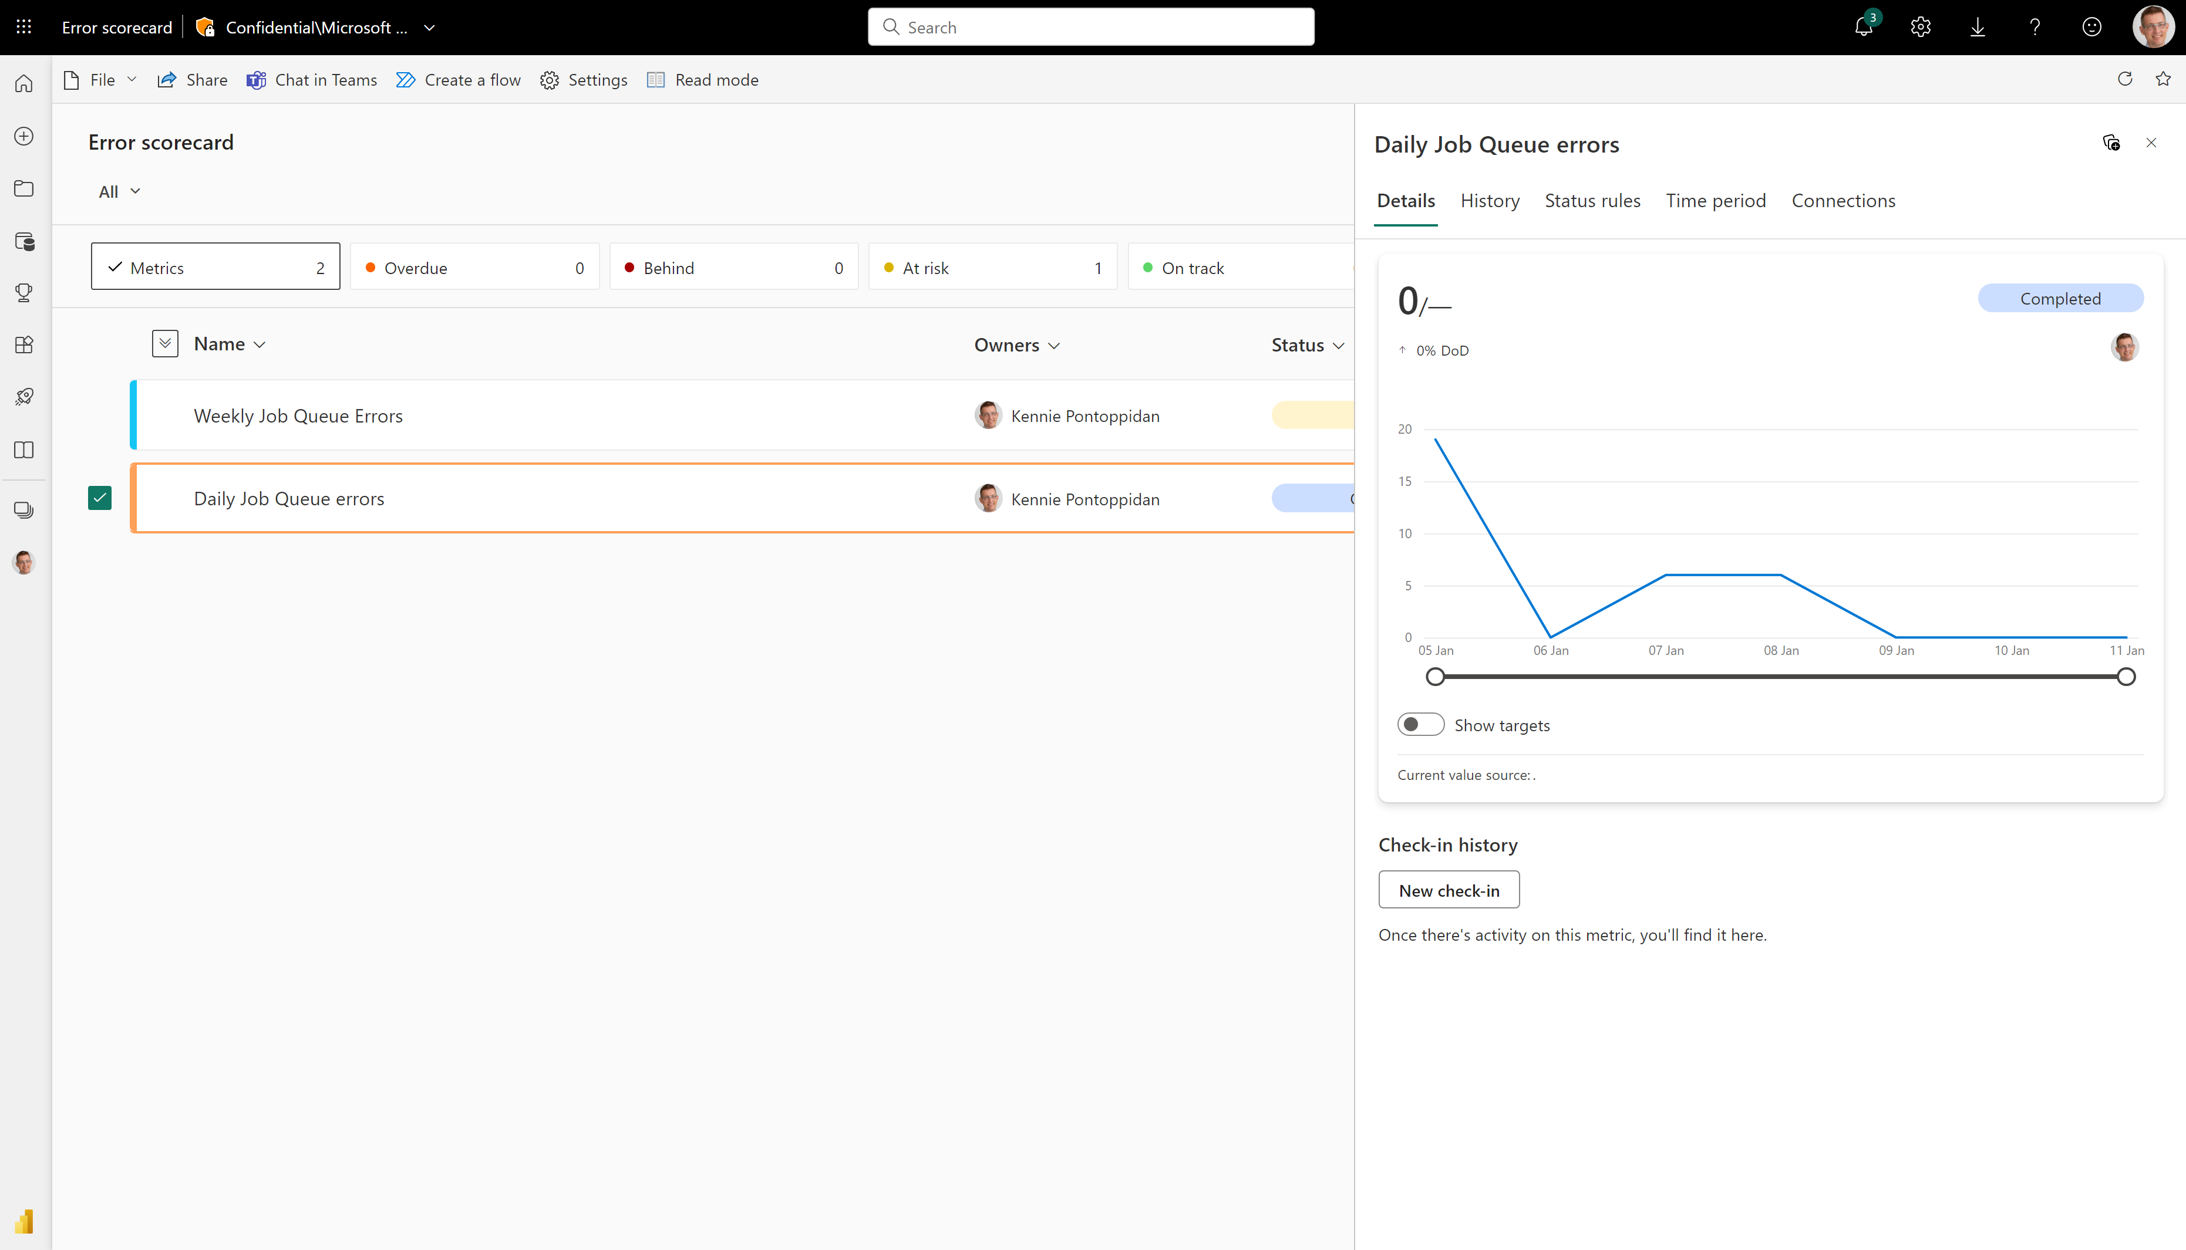
Let it simmer for a few days…

Slide 12
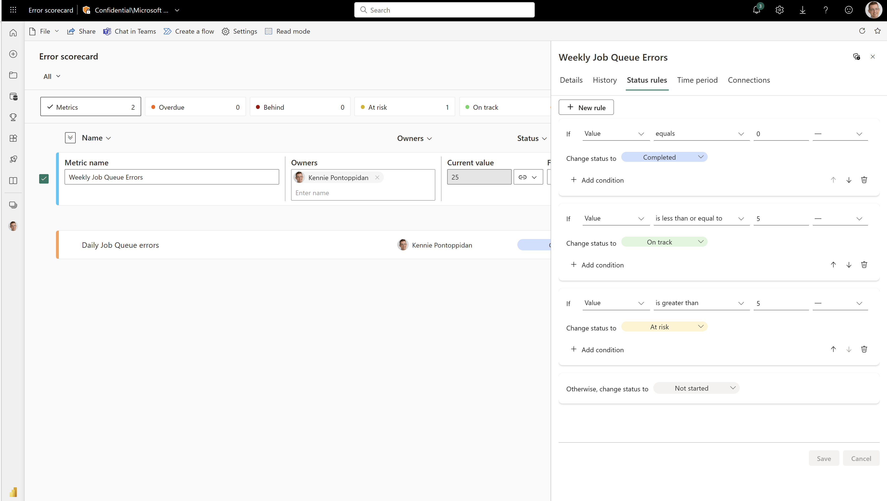
And setup state rules for status

Slide 13
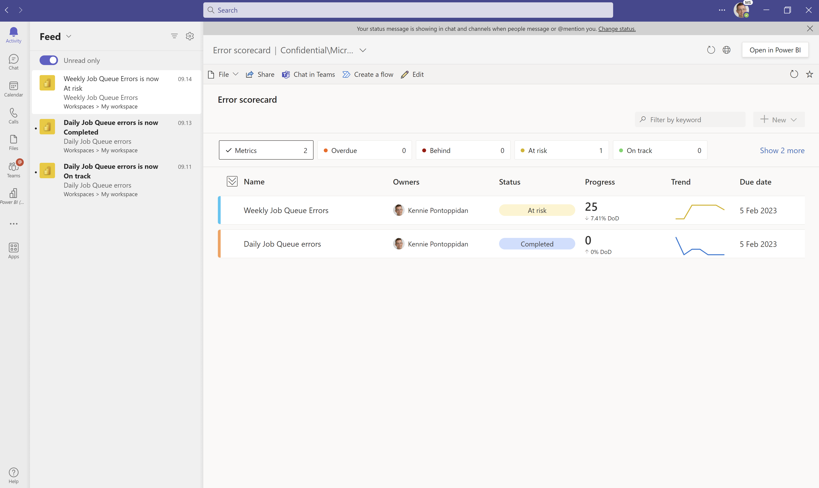
State changes goes automagically to Teams

Slide 14
Summary – data-driven go-lives
Set up telemetry
Provides data for everything
Install and configure the Power BI app
Gives visibility into usage, errors, and performance for the project team and the customer sponsor
Setup Power BI metrics on key error types
Helps track progress of errors before/during go-live
Setup Alerts on key error types
Helps track progress of errors after go-live

